Slide 1
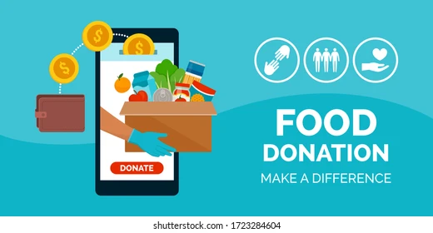
FOOD DONATION SYSTEM
A Project by:
Group Vikings
Akshay Patel (NUID: 1388394)
Jayesh Nagarkar (NUID: 1573131)
Rachit Singh (NUID: 1569294)

Slide 2
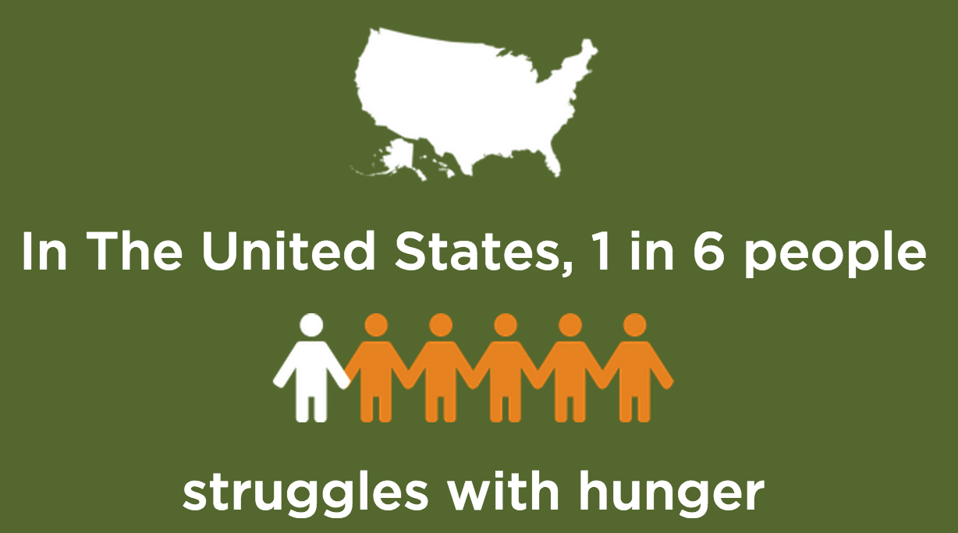
Problem Statement
Respect for food is a respect for life, for who we are and what we do.
It may not seem real but, 1 in every 6 people in America, struggles with hunger. The problem of food wastage is spreading at an alarming rate day by day. In fact, as per statistics, in India, the amount of food wasted per day is equal to the amount of food consumed by the whole of UK per day.

Slide 3
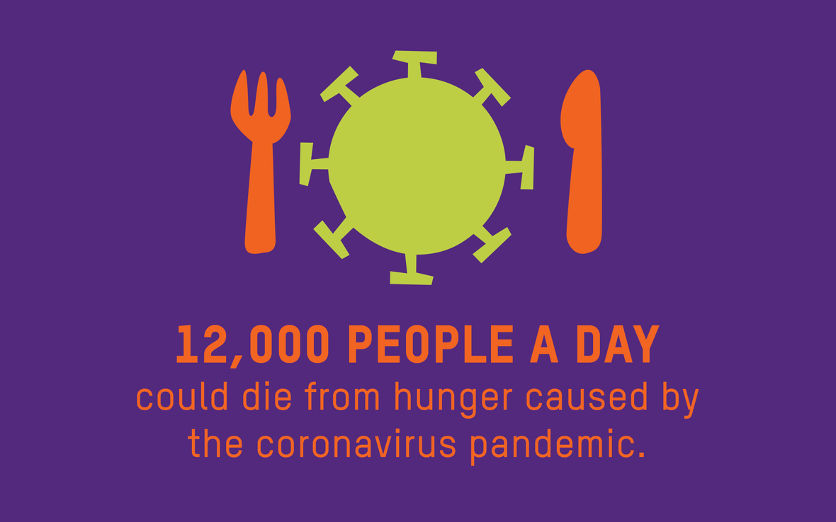
Continued...
This is all a result of unthrifty expenditure of food at restaurants, big fat parties, weddings, etc. There is a huge disparity between the amount of food wasted and the number of people in the world sleeping without having even one full meal every day.
Also, this COVID-19 pandemic has increased the plight of people even more. The lower-class people are finding it more and more hard to get on with a day’s meal. Hence, our main aim is to address world’s one of most major and alarming issues, HUNGER and FOOD WASTAGE.

Slide 4
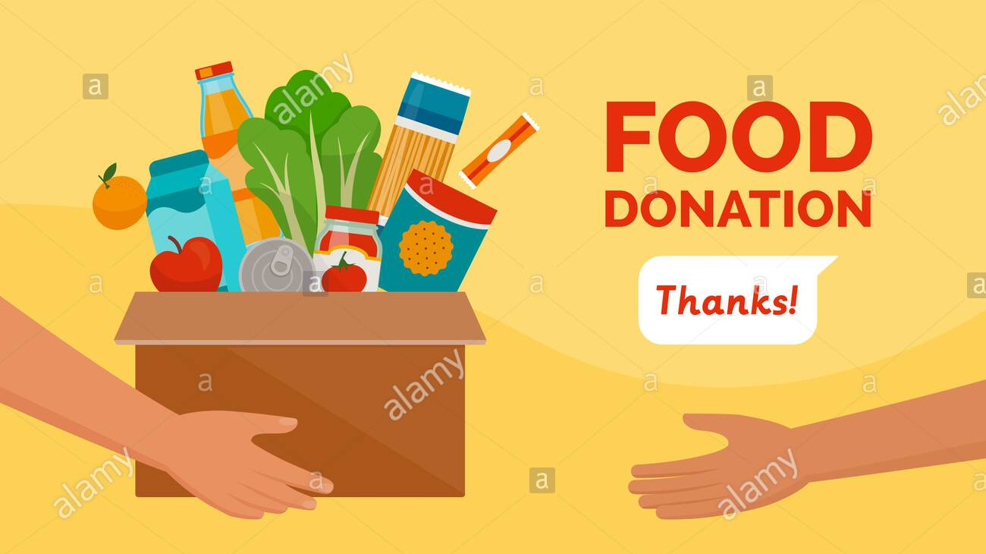
Our Solution
Motivated by this quote, “the act of donating is about making a difference in the society”, we implemented a system, an application where we try to solve this issue of food wastage by facilitating FOOD DONATION.

Slide 5
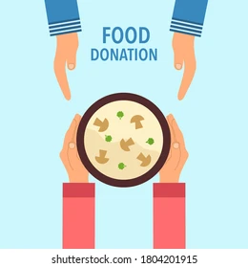
Continued...
Our application focuses on connecting people who are in dire need of food with the ones who can provide help to the ones in need. We try to bring various enterprises like Food Donating entity, Food Safety Officer, Food Delivery executive and Food Receiver together to facilitate food donation procedure.
By using our proposed application, the donating entity can identify the ones who are in need as they will place order for the food. To ensure food quality, food safety entity is also involved in the procedure who can certify if the food is safe to consume and food delivery entity can help connect the donator to the receiver.

Slide 6
Architecture of the System

Slide 7
THANK YOU
Please don’t waste food, and yes, Donate.
Any Questions?

